Slide 1
My Screenings Tab

Slide 2
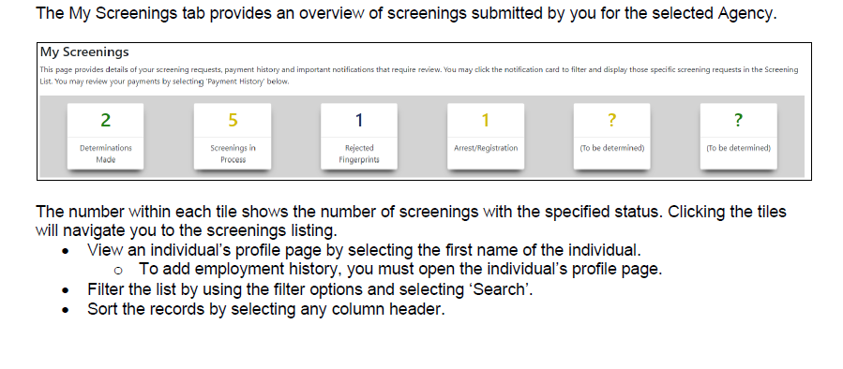

Slide 3
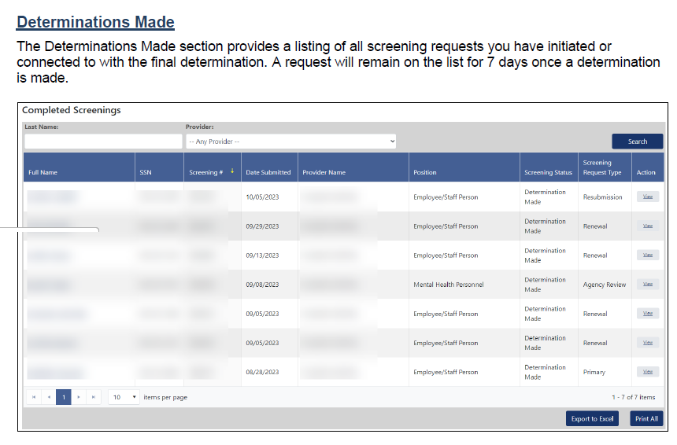

Slide 4
